Slide 1
Feature Scaling

Slide 2
What We’ll Cover
Why?
Feature Scaling
Min-Max
Standardization
Log-transforms
Percentiles
Threshold cut-offs
Image data

Slide 3
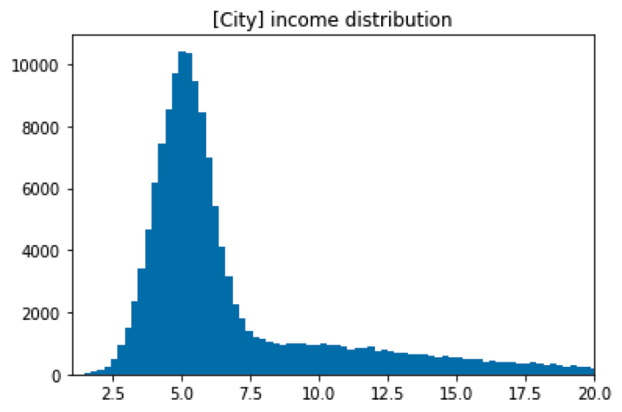

Why?
Uneven Datasets
ML algorithms usually don’t do well with varying feature scales (decision trees are an exception)
Within a single feature
Usually don’t need to re-scale targets, usually just features
Always want to train transformation only on the seen training set (and then apply it on the validation/testing set)
Notes:
Photo: https://www.flickr.com/photos/107442568@N08/12547327134

Slide 4
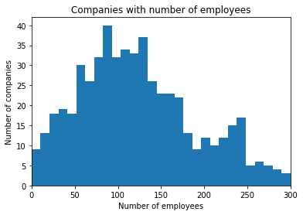
Why?
Uneven Datasets
ML algorithms don’t do well with varying feature scales
Within a single feature
Across a set of features
Notes:
Photo: https://www.flickr.com/photos/107442568@N08/12547327134

Slide 5
1586764800
Why?
Uneven Datasets
ML algorithms don’t do well with varying feature scales
Within a single feature
Across a set of features
Make feature ranges comparable
Notes:
Photo: https://www.flickr.com/photos/107442568@N08/12547327134

Slide 6
Min/Max Scaling
Min Max Scaling
All ranges go between 0-1 (or other custom range)
However, distribution of data can still be uneven
Notes:
Photo: https://www.flickr.com/photos/107442568@N08/12547327134

Slide 7
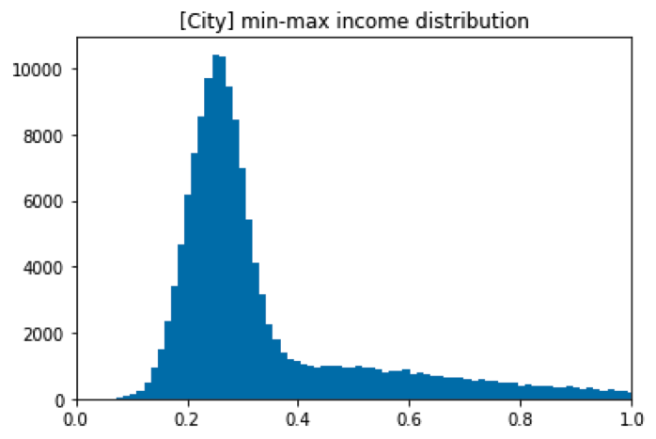
Min/Max Scaling
Min Max Scaling
All ranges go between 0-1 (or other custom range)
However, distribution of data can still be uneven
Con: inherent uneven distribution is maintained
Notes:
Photo: https://www.flickr.com/photos/107442568@N08/12547327134

Slide 8
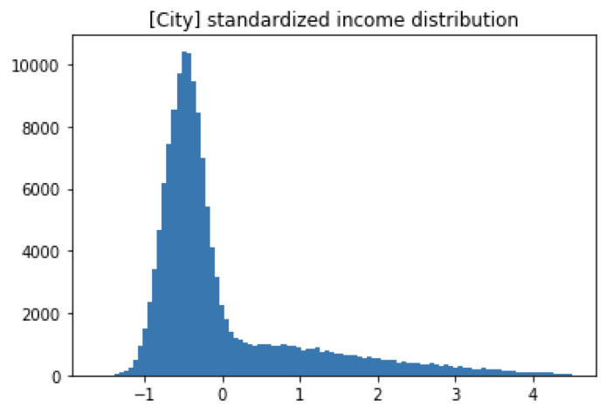
Standardization
Standard Scaling
No set absolute range
Distribution of data is much more controlled
Transformation Z = (X-mean)/std.dev.
Mean = 0 and unit variance
Much less affected by outliers
Notes:
Photo: https://www.flickr.com/photos/107442568@N08/12547327134

Slide 9
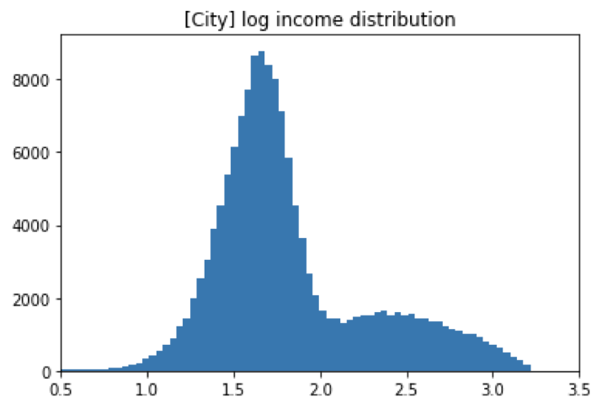
Log transforms
Log transform
No set absolute range
Reduce data scale down dramatically,
Larger values come closer together (difference between 1-10 = difference between 10-100)
Notes:
Photo: https://www.flickr.com/photos/107442568@N08/12547327134

Slide 10
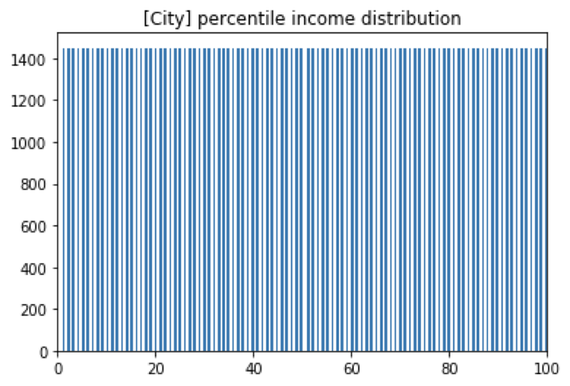
Percentiles
Percentiles
Equal distribution of data
Bucketed to create equal dense regions
Notes:
Photo: https://www.flickr.com/photos/107442568@N08/12547327134

Slide 11
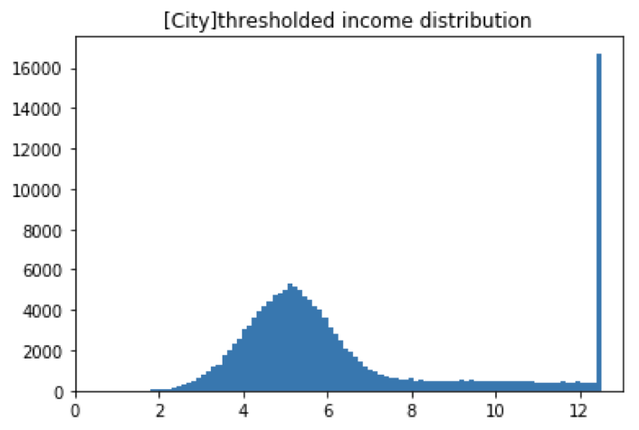
Threshold cut-offs
Threshold cut-offs
Decide on cut-off based on physical meaning, or use percentiles
Artificially reduced range from 2.5 -> 20 to 2.5 -> 12.5
Problem here is tail is still long (compared to width of distribution, and threshold value is very high.
Notes:
Photo: https://www.flickr.com/photos/107442568@N08/12547327134

Slide 12
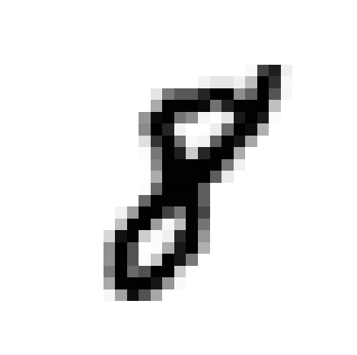


Image Data
Image data
Rotating
Resizing
Centering
Notes:
Photo: https://www.flickr.com/photos/107442568@N08/12547327134

Slide 13
Image Data
Image data
Rotating
Resizing
Standardizing image dimensions and orientation can help improve model performance (however, you can also do the opposite and resize and rotate your training images, using several copies of transformed images to try and train more general classifiers)
Notes:
Photo: https://www.flickr.com/photos/107442568@N08/12547327134

